Slide 1
^{Investigating} diversity and population structure in Western Chimpanzees using genomic data from fecal samples
Barney Couch and Aislyn Taylor

Slide 2
Our Data
We received data collected from western chimpanzees:
Chromosome 21 genotypes
X Chromosome genotypes (Kierra, Peanut)
Genotypes both derived from blood & fecal samples.
Mitochondrial sequences for all Chimpanzee subspecies.

Slide 3
Aims
Is genomic data collected from fecal samples accurate enough for genetic analysis when compared to data collected from blood samples?
What can we learn about the heterozygosity and population structure of the sampled individuals?

Slide 4
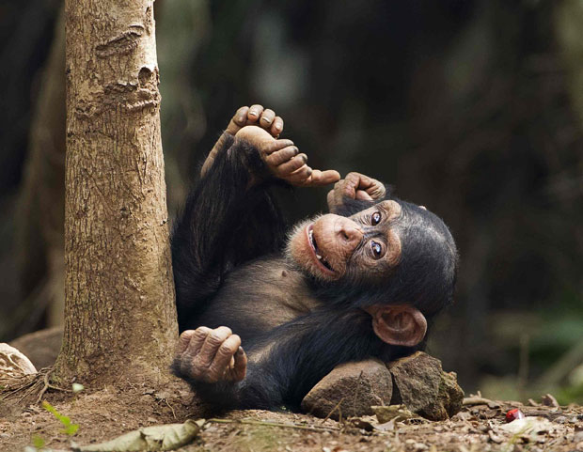
Western Chimpanzees
We are endangered. There are only 21,000-55,000 left of us in the world!
Western Chimpanzees used to be found in 13 different countries spanning a large range, however they are only found in small populations due to fragmentation of their habitat.
The chimps that our samples are collected from are called: Flint, Coty, Kierra, Peanut, Sopulu and Judd.

Slide 5
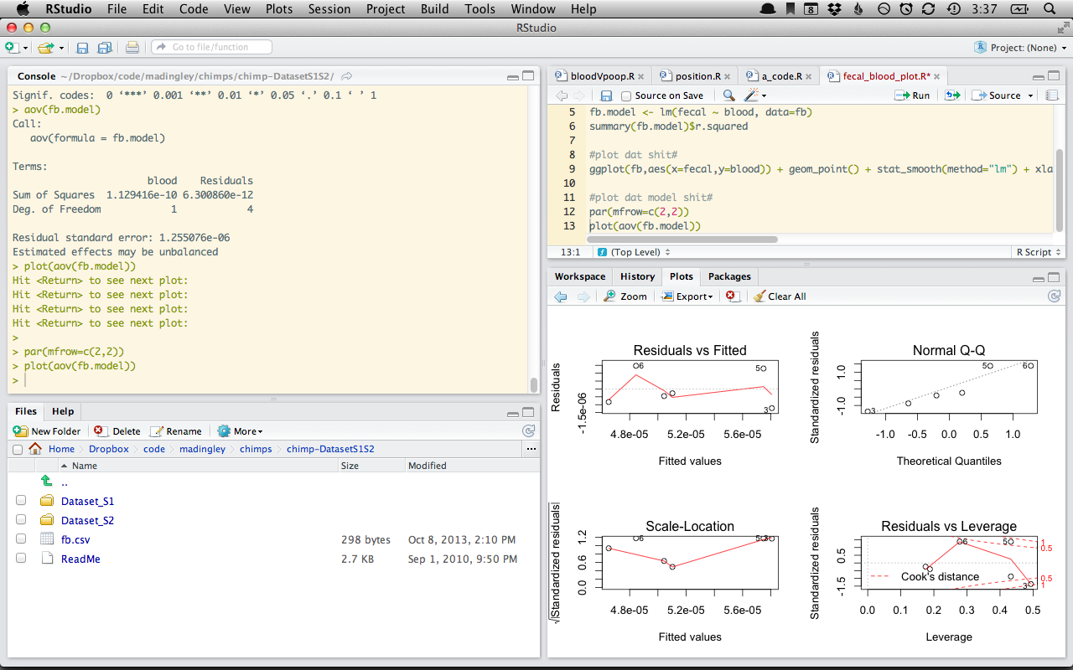
Analysis Software
R + “ape”, “smatr”, “ggplot2”
CLC Sequence Viewer
FigTree

Slide 6
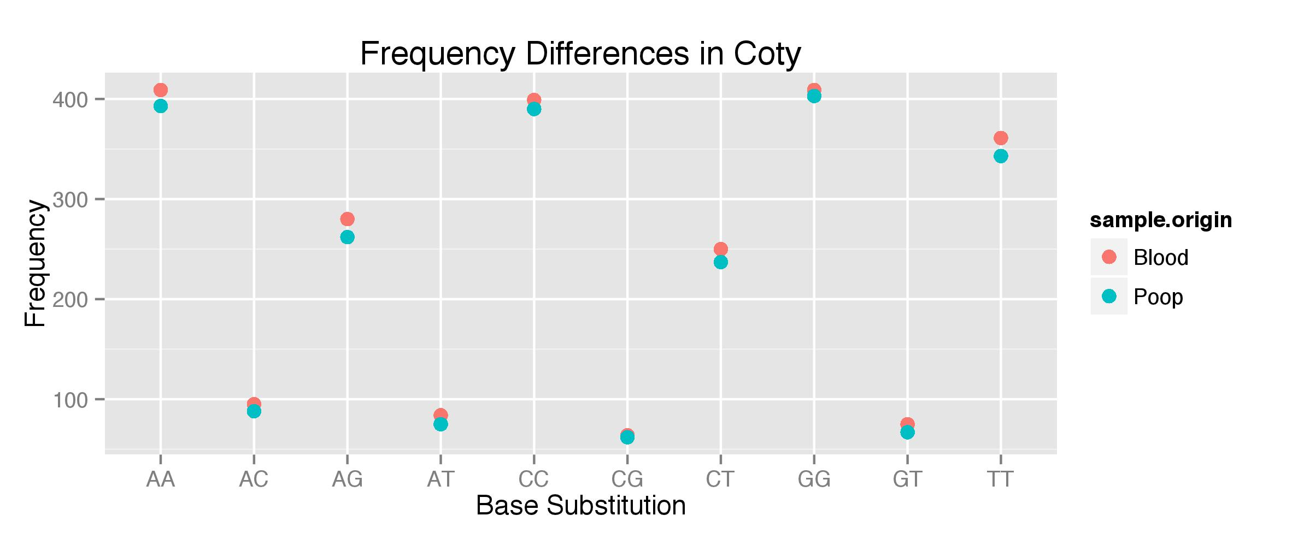
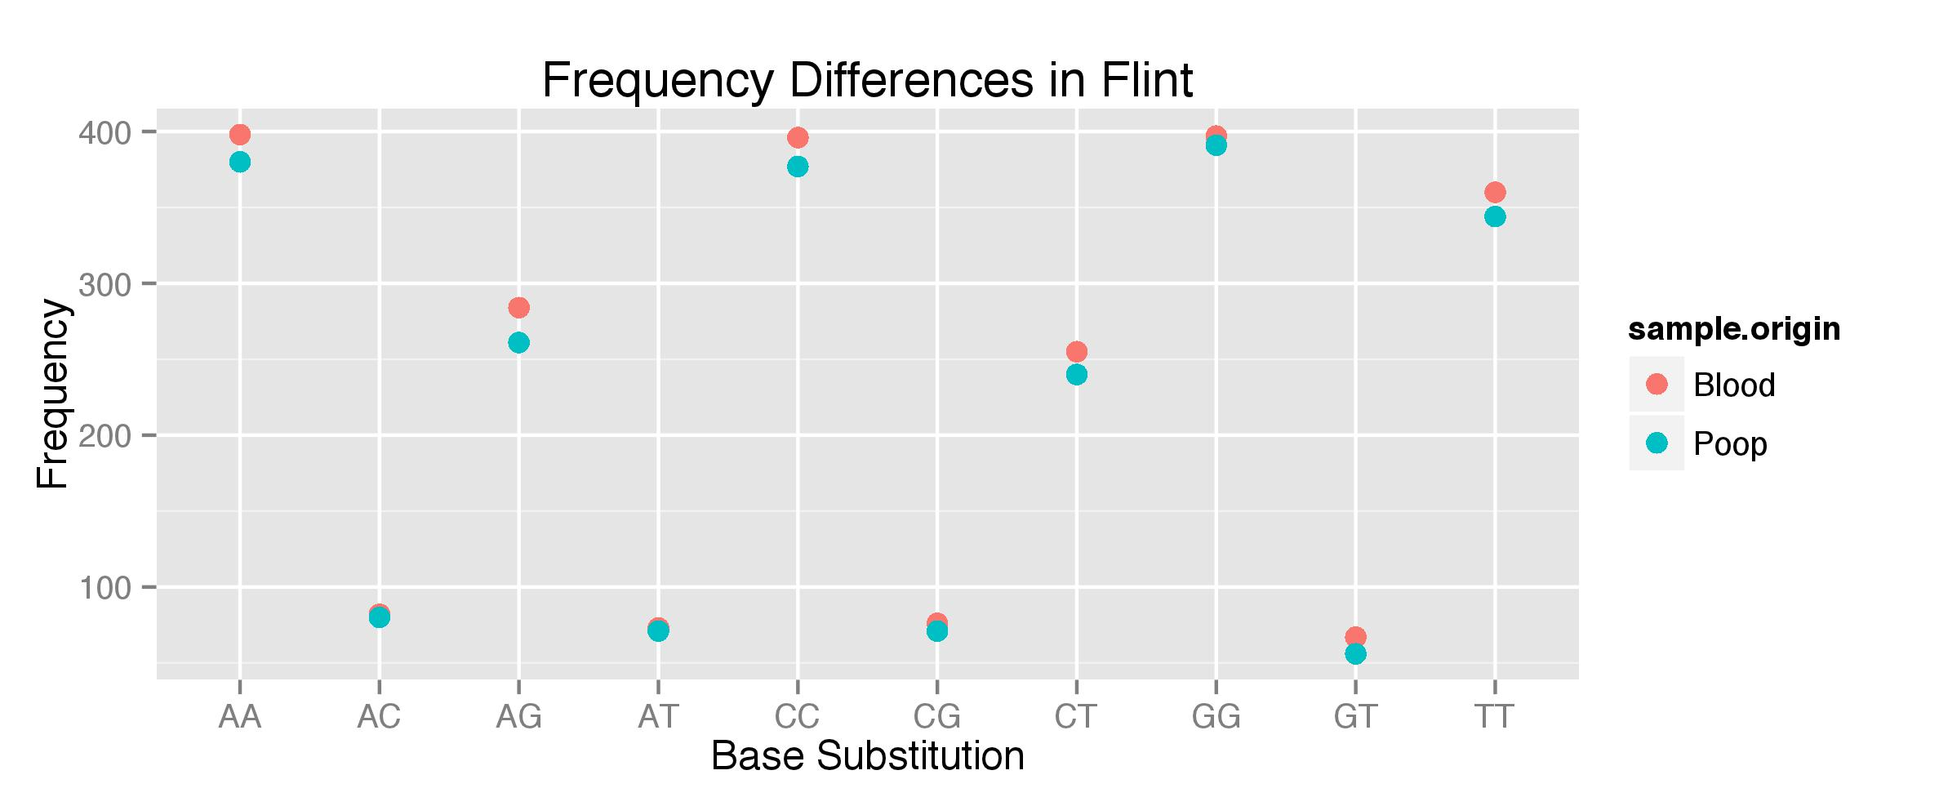
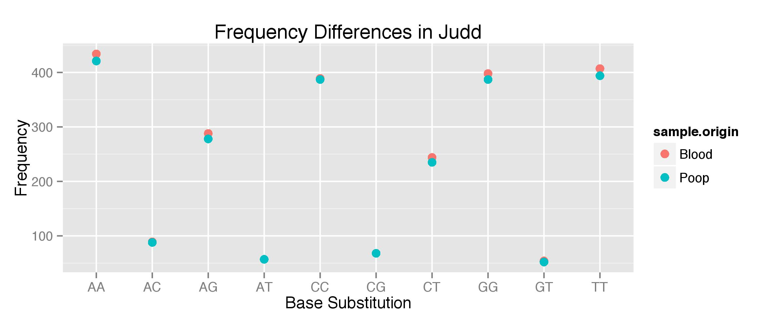
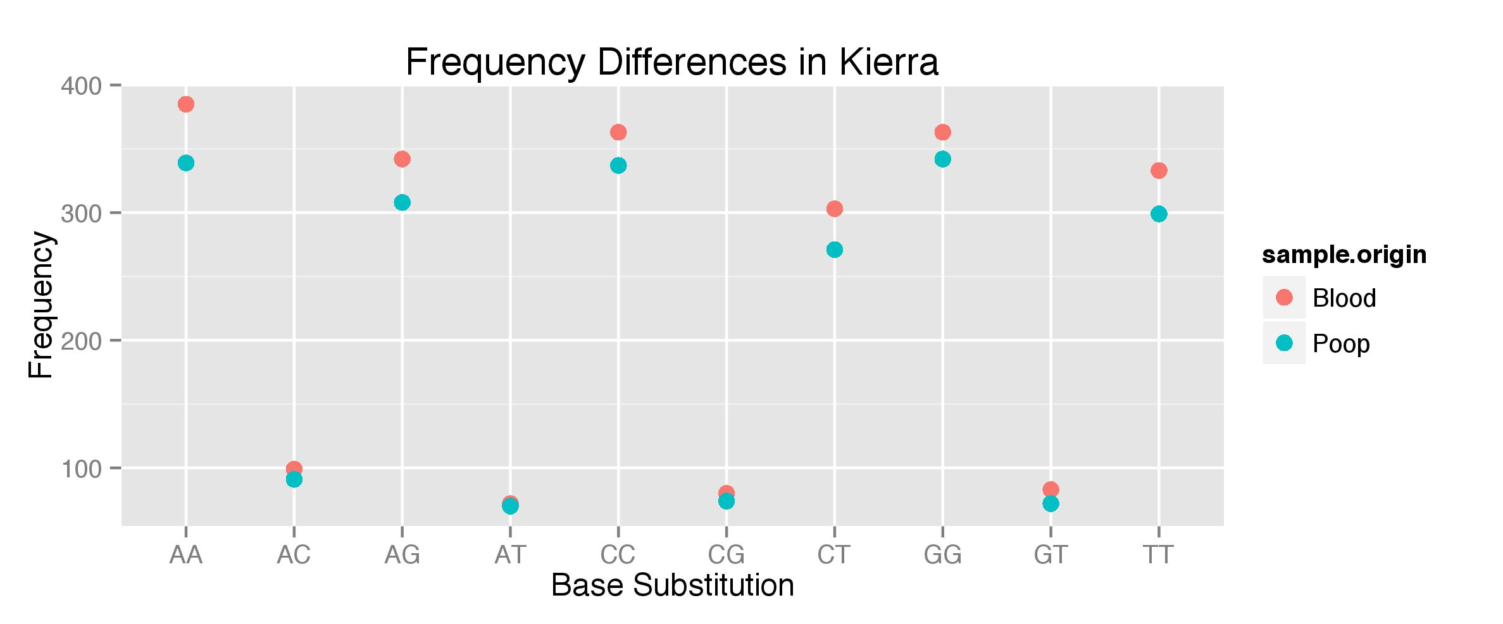
Frequency Differences

Slide 7
Heterozygosity
The number of heterozygous positions per base pair.
 | flint | coty | kierra | peanut | sopulu | judd | average
21-blood | 5.37E-05 | 5.44E-05 | 6.28E-05 | 4.90E-05 | 6.21E-05 | 5.13E-05 | 5.56E-05
21-fecal | 5.00E-05 | 5.08E-05 | 5.69E-05 | 4.57E-05 | 5.88E-05 | 4.99E-05 | 5.20E-05
X-blood | na | na | 1.56E-05 | 1.62E-05 | na | na | 1.59E-05
X-fecal | na | na | 1.34E-05 | 1.57E-05 | na | na | 1.45E-05

Slide 8
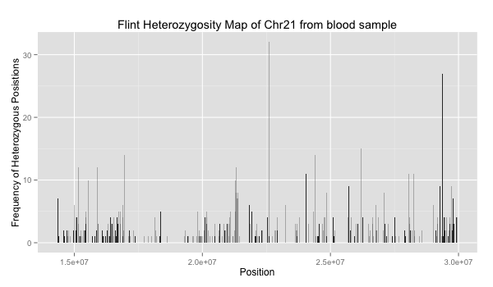
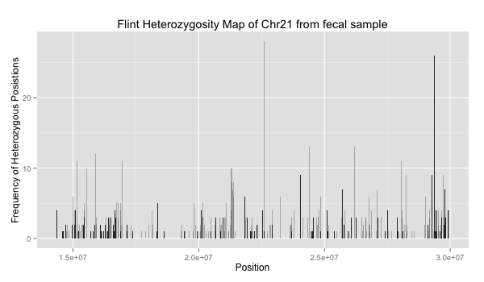
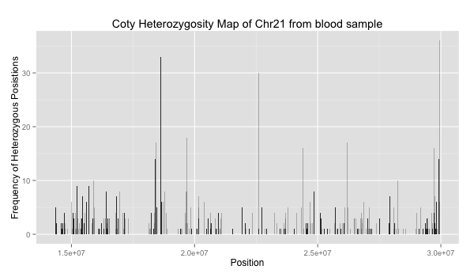
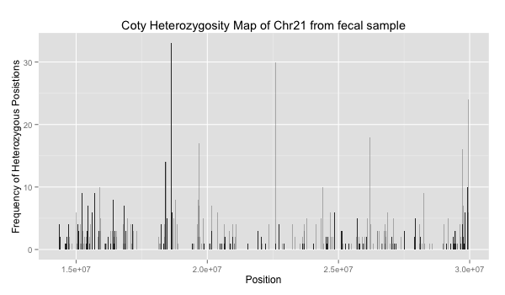
Heterozygosity

Slide 9
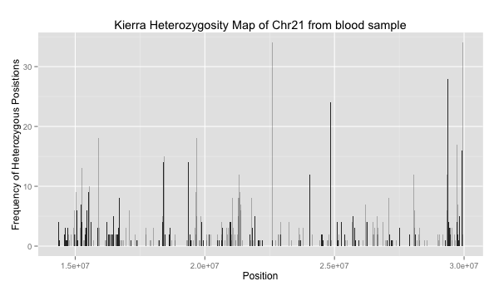
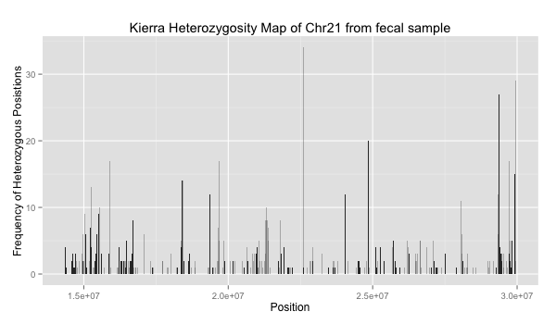
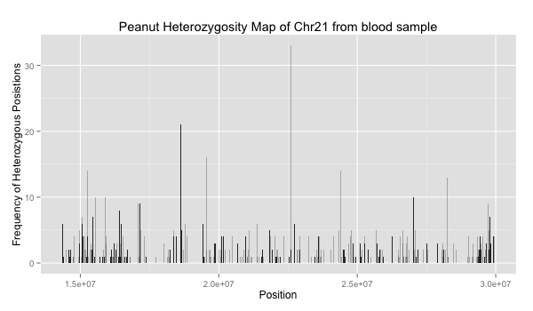

Heterozygosity

Slide 10
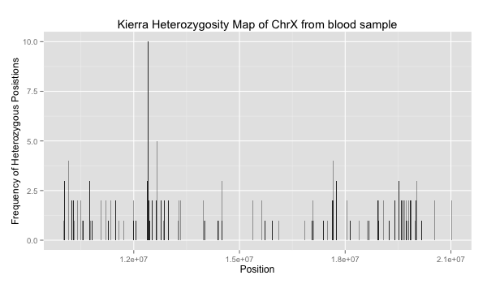
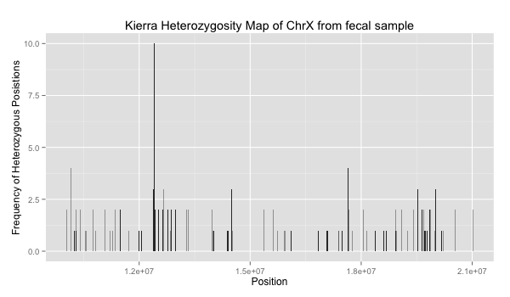
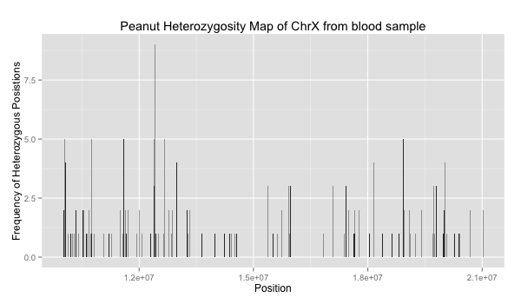
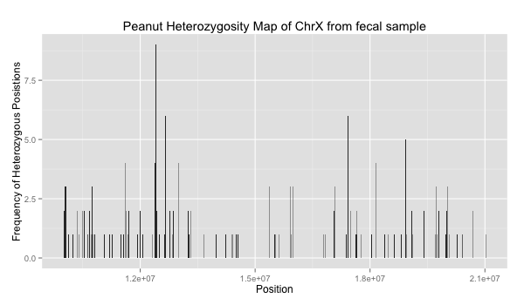
Heterozygosity
Large amount of heterozygosity at ~1.25e^7 corresponds to the teneurin transmembrane protein 1 coding gene

Slide 11
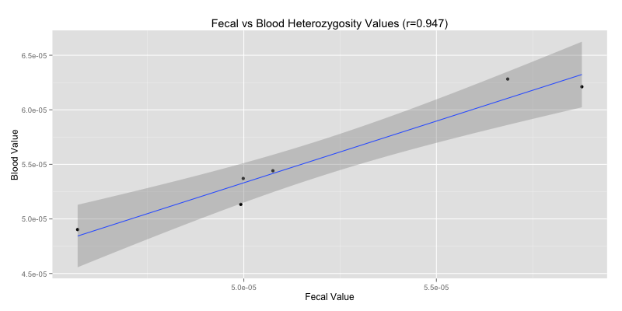
Heterozygosity Analysis

Slide 12
Heterozygosity Analysis
Slope analysis: H0=the data sits along a line with gradient 1. => p=0.26 => the data is consistent with being modelled by a straight line with gradient 1
Wilcoxon test (paired) of blood and fecal heterozygosity values:
P=0.03125

Slide 13
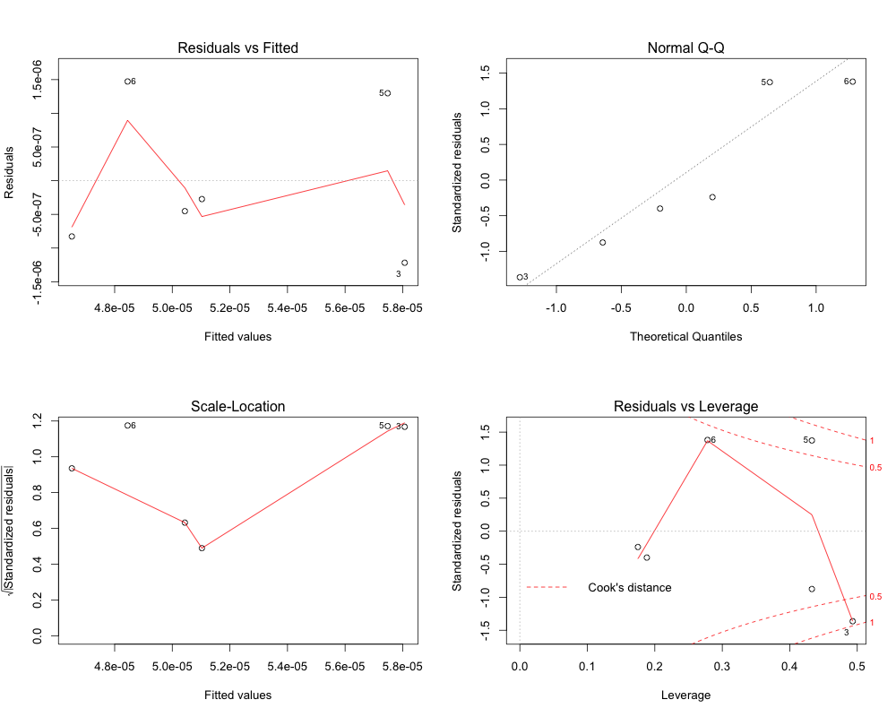
Heterozygosity Analysis (ANOVA)

Slide 14
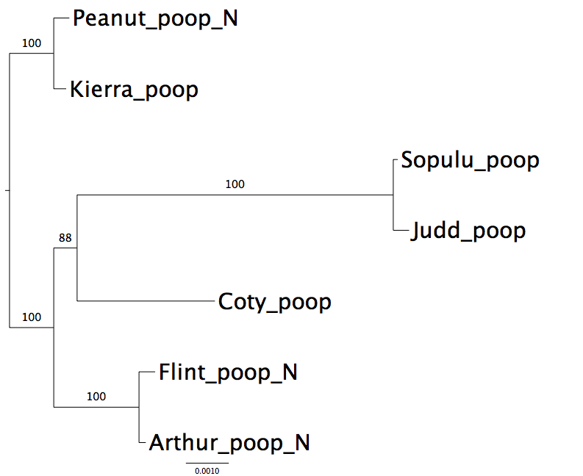
Family relationships (fecal samples)

Slide 15
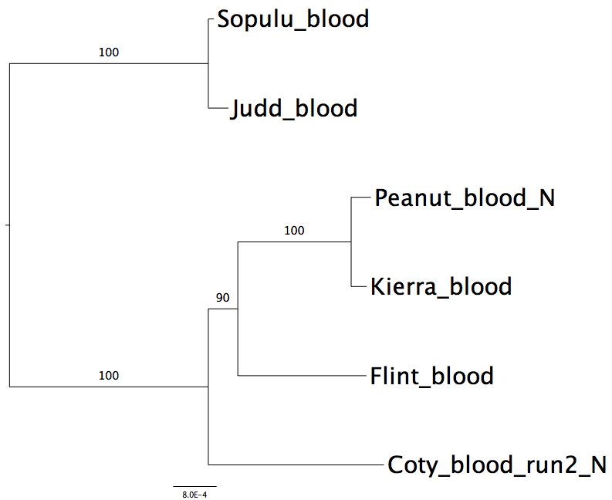
Family relationships (blood samples)

Slide 16
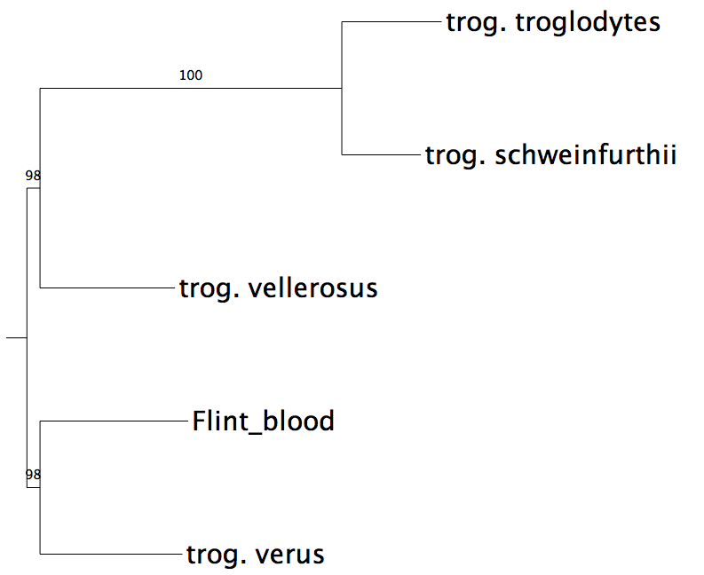
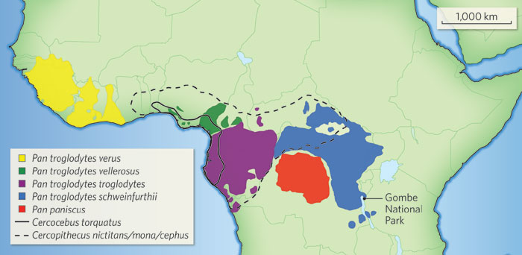
Inter-species relationship

